Slide 1
FISH270
Lec17

Slide 2
Case Studies

Slide 3
Going into different environments

Slide 4
Environments
Estuaries - Intertidal Coastal Environments
Open Ocean
Deep Ocean

Slide 5
Quick Ecology Review

Slide 6
Types of Aquatic Biomes
An organism’s environment has both physical and biological components
The abiotic components include temperature, precipitation, wind, and sunlight
The biotic (living) components consist of other members of the organism’s own species, as well as individuals of other species

Slide 7
Types of Aquatic Biomes
Three key physical factors affect the distribution and abundance of organisms:
Nutrient availability
Water depth
Water movement

Slide 8
Salinity
The proportion of solutes dissolved in water determines its salinity
These solutes possess a positive charge like sodium, potassium, magnesium, and calcium that combines with those of a negative charge like chlorine, bromine, and fluorine to form salts
Salinity has dramatic effects on osmosis and water balance in organisms

Slide 9
Water Depth
Water depth dictates how much light reaches the organisms that live in a particular region
Water absorbs and scatters light, so the amount and types of wavelengths available to organisms change dramatically as water depth increases, as does light intensity
The turbidity, or cloudiness, of the water is an important determination of light penetration
Light has a major influence on productivity—the total amount of carbon fixed by photosynthesis per unit area per year

Slide 10
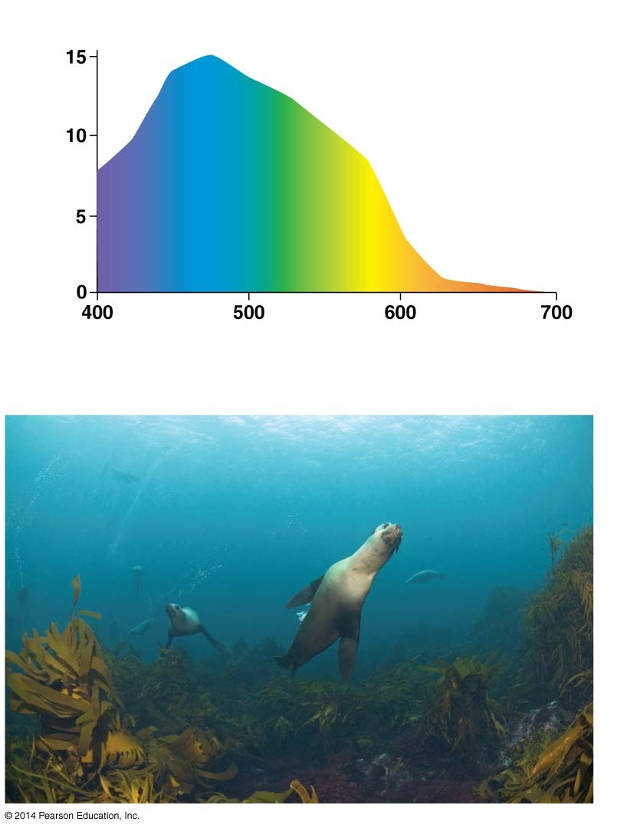
Figure 52.18
(a) Red wavelengths are not available underwater.
Note that many organisms require wavelengths of about 680 nm for peak photo- synthetic efficiency
Percentage of visible light at 10 m depth in seawater
680
Wavelength (nm)
(b) Blue wavelengths dominate underwater.
Notes:
Figure 52.18 Light Is Limited Underwater.

Slide 11
Water Flow
The rate of water movement and water depth are the key physical factors that shape the environments in aquatic ecosystems
Water movement is a critical factor in aquatic ecosystems because it presents a physical challenge. It can literally sweep organisms off their feet

Slide 12
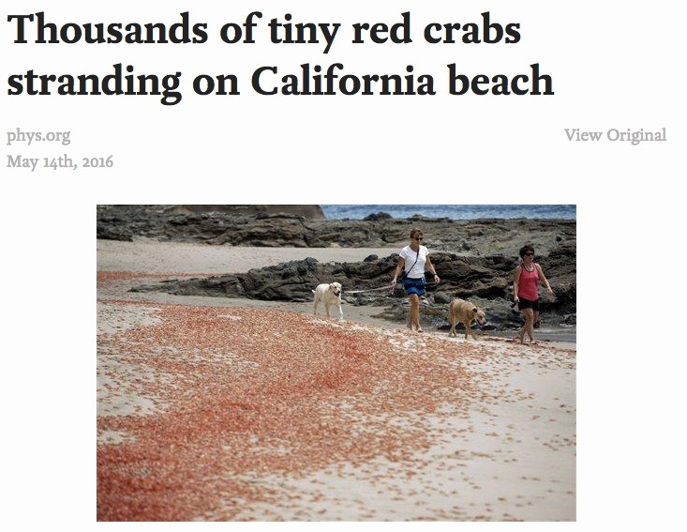

Slide 13
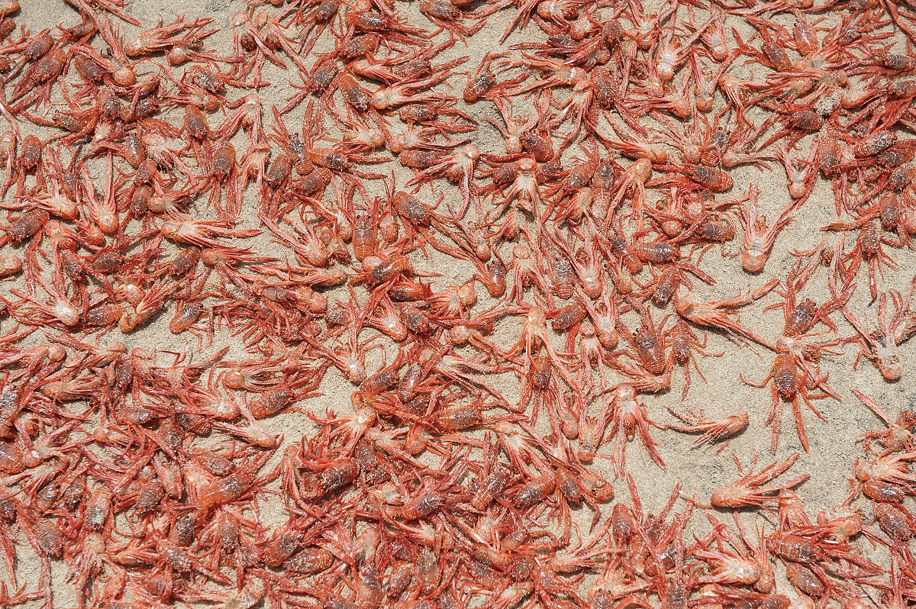
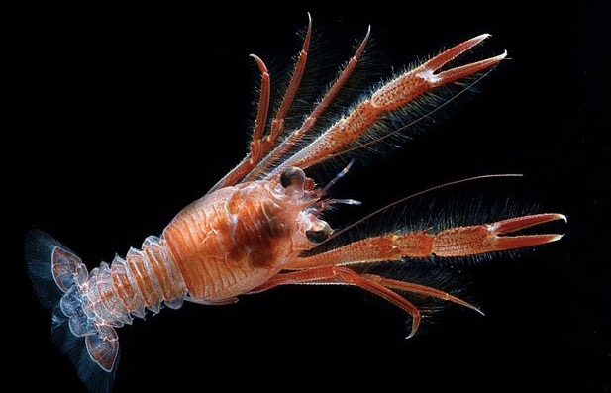
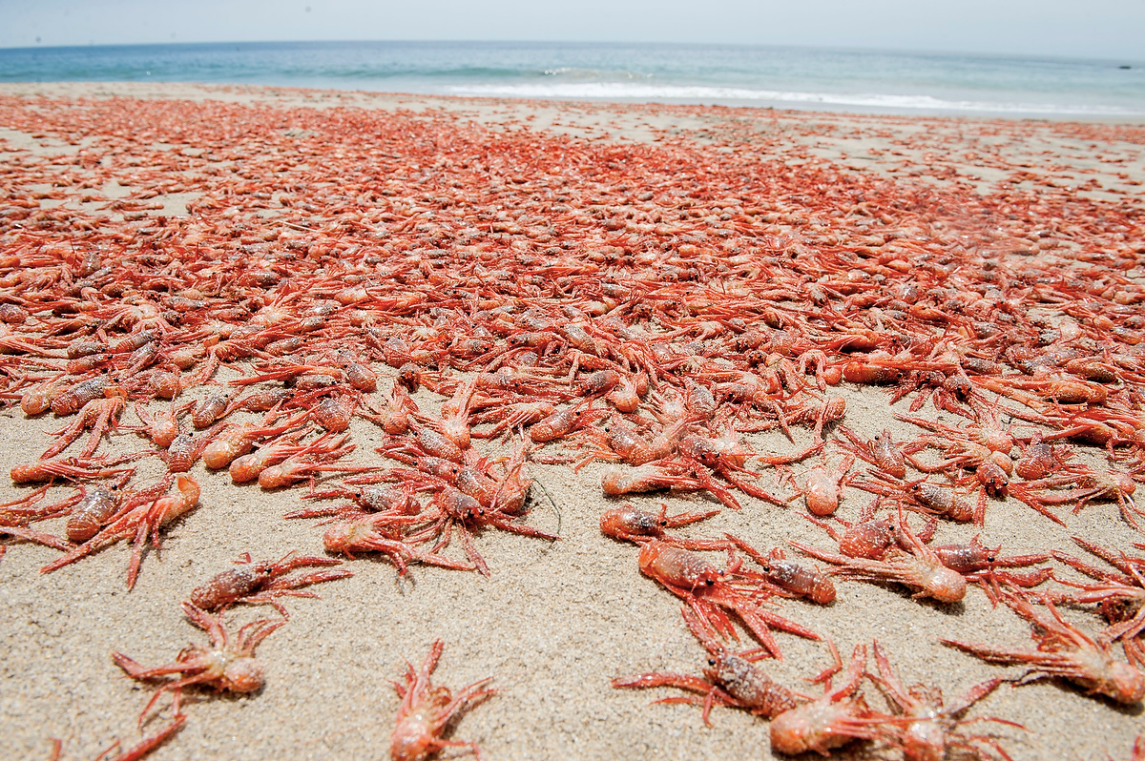

Slide 14
Nutrient Availability
Nutrients tend to be washed away in moving water and fall to the bottom in still water. Thus they are in short supply in many aquatic ecosystems
Nutrient levels are important because they limit growth rates in the photosynthetic organisms that provide food for other species
Ocean upwelling and lake turnover affect nutrient availability by bringing nutrients from the bottom up to the water surface

Slide 15
Ocean Upwelling
Nutrients in the sunlit surface waters are constantly lost in the form of dead organisms that rain down into the depths
In certain coastal regions, nutrients are brought up to the surface by currents that cause upwellings
As the surface water moves away from the coast, it is steadily replaced by water moving up from the ocean bottom
The upwelling water is nutrient rich

Slide 16
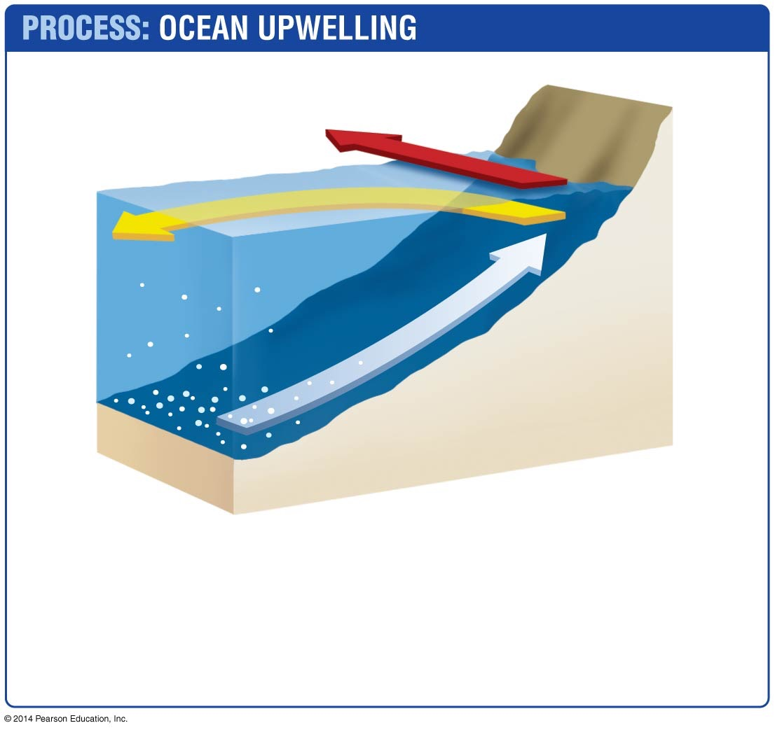
Figure 52.19
Wind
Surface water
Upwelling
Nutrients
1. Winds blow: Along the coast of Peru, the prevailing winds blow north, moving water at the surface.
2. Surface water moves: As the Earth rotates, the moving surface water is forced offshore.
3. Upwelling: As surface water leaves, it is replaced by nutrient-laden water welling up from the bottom.
Notes:
Figure 52.19 Ocean Upwellings Bring Nutrients to the Surface.

Slide 17
Freshwater/Marine Environments: Estuaries
An estuary forms where a river meets the ocean and freshwater mixes with salt water
An estuary includes slightly saline marshes as well as the body of water that moves in and out of these environments
Salinity varies with changes in river flows and with proximity to the ocean
Salinity has dramatic effects on osmosis and water balance
Species that live in estuaries have adaptations that allow them to cope with variations in salinity

Slide 18
Freshwater/Marine Environments: Estuaries
Most estuaries are relatively shallow, but water depth may vary dramatically
Water flow fluctuates daily and seasonally due to tides, storms, and floods
This fluctuation alters salinity
Species that live in estuaries have adaptations that allow them to cope with variations in salinity
Estuaries are among the most productive environments

Slide 19
Marine Environments: The Oceans
The world’s oceans form a continuous body of salt water. Regions within an ocean can vary markedly in their physical characteristics
In terms of water depth, the ocean has six regions:
Intertidal zone
Consists of a beach that is exposed to the air at low tide but submerged at high tide

Slide 20
Marine Environments: The Oceans
Oceanic zone
The “open ocean”—the deepwater region beyond the continental shelf
Benthic zone
The bottom of the ocean

Slide 21
Marine Environments: The Oceans
Photic zone
The intertidal and sunlit regions of the neritic, oceanic, and benthic zones
Aphotic zone
Areas that do not receive sunlight

Slide 22
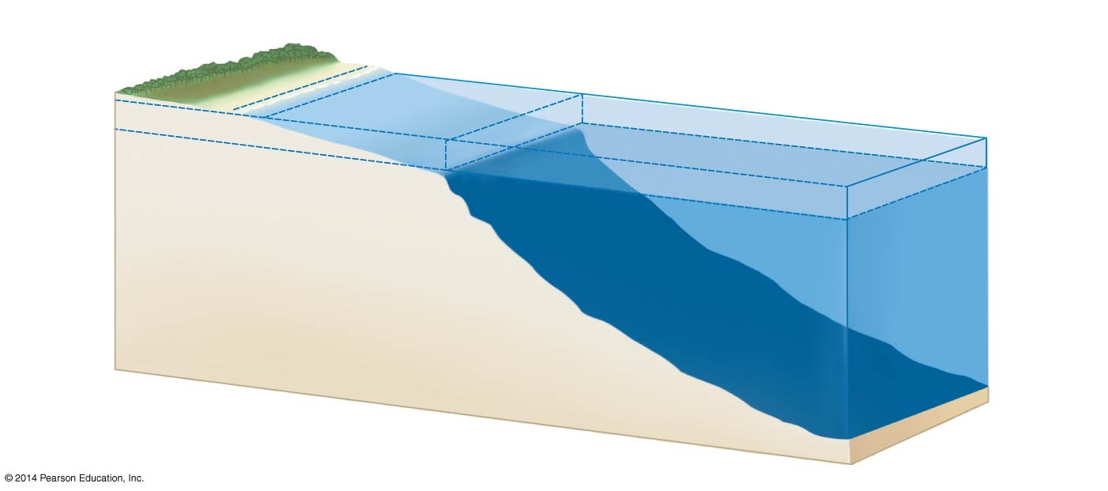
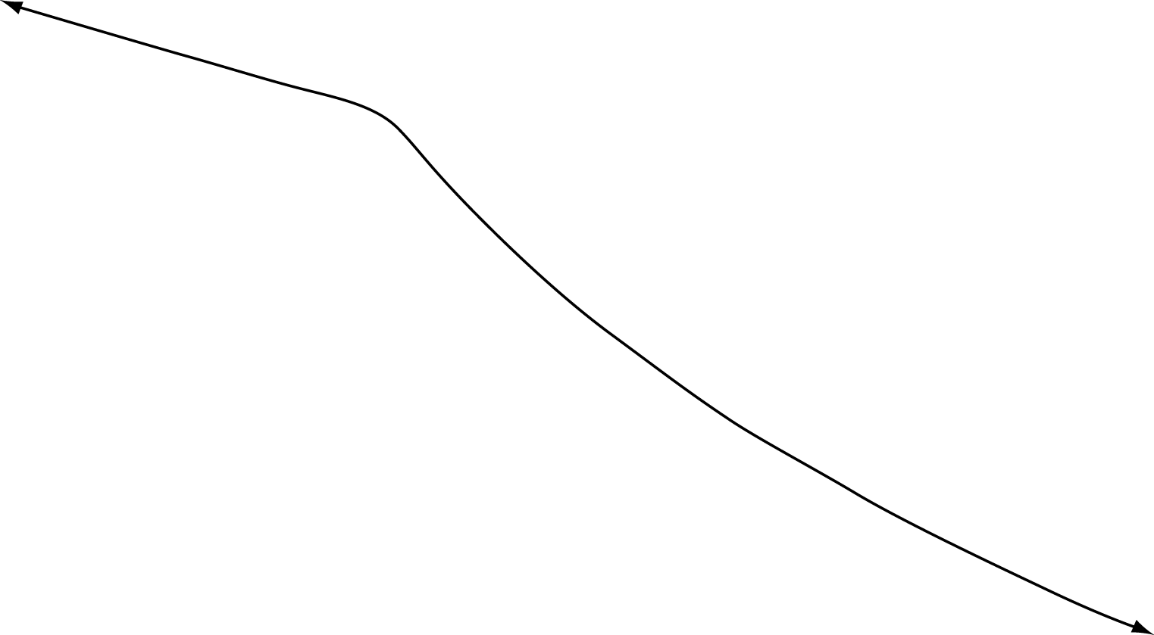
Figure 52.22
Intertidal zone
Neritic zone
Oceanic zone
Sea level 200 m
Photic zone
Continental shelf
Aphotic zone
Benthic zone
Notes:
Figure 52.22 Oceans Have Distinctive Zones.

Slide 23
Marine Environments: The Oceans
Water movement in the ocean is dominated by different processes at different depths
Each zone in the ocean is populated by distinct species that are adapted to the physical conditions present
The intertidal and neritic zones are the most productive
The neritic zone includes coral reefs, which are among the most productive environments on Earth
The photic and aphotic zones are not as productive

Slide 24
Estuaries - Intertidal Coastal Environments

Slide 25
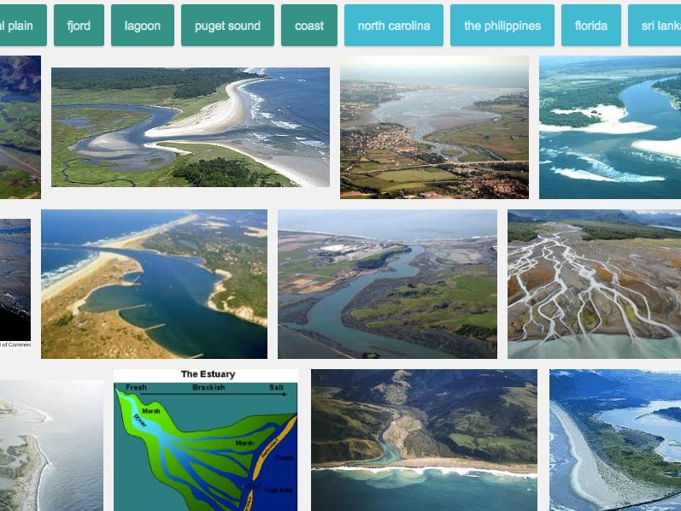

Slide 26
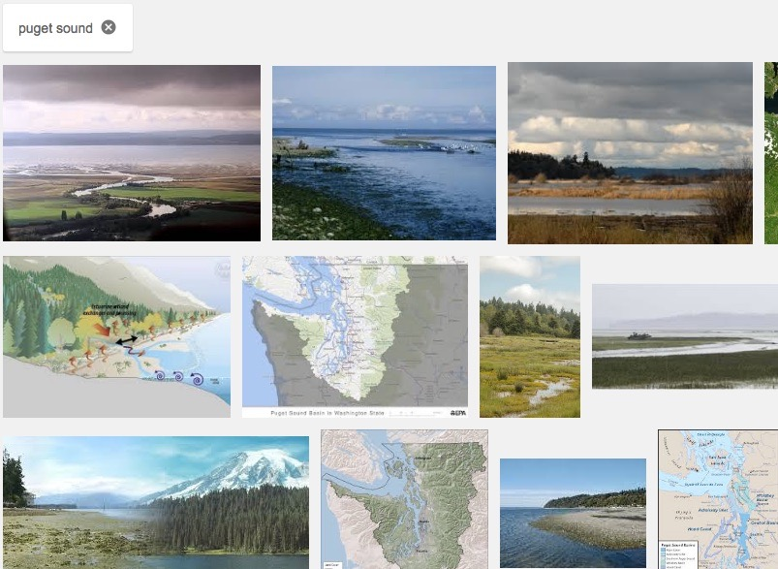

Slide 27
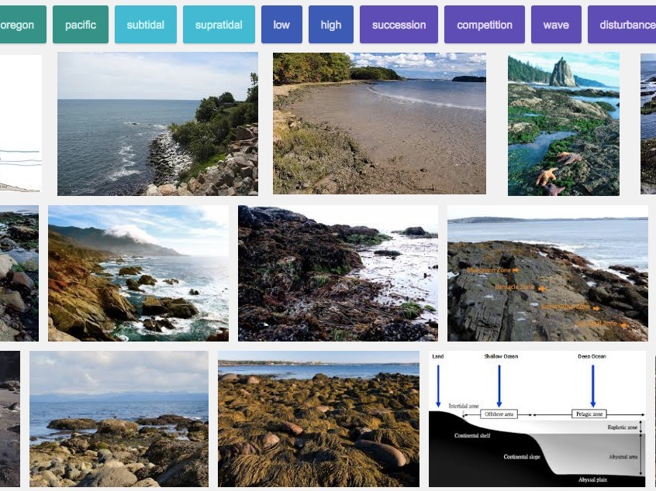

Slide 28
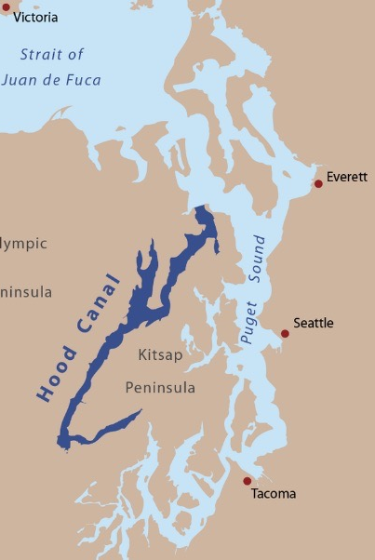
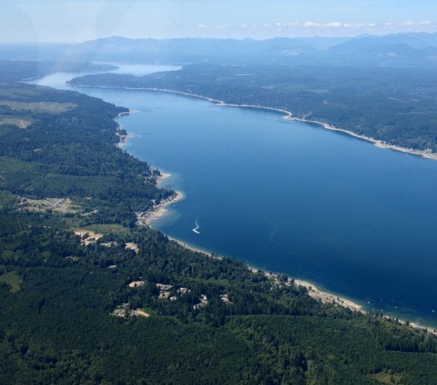
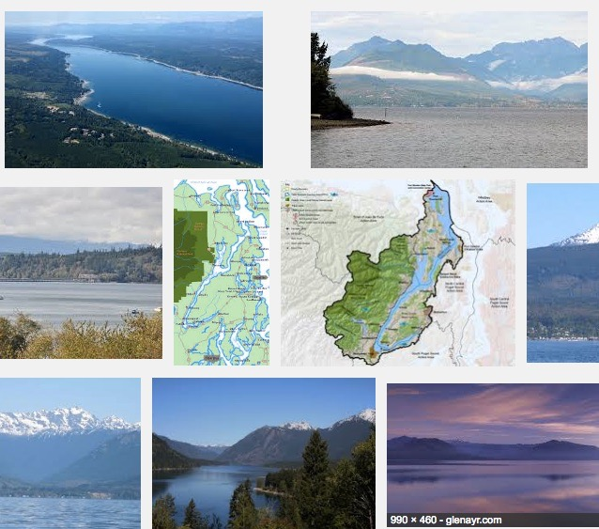

Slide 29
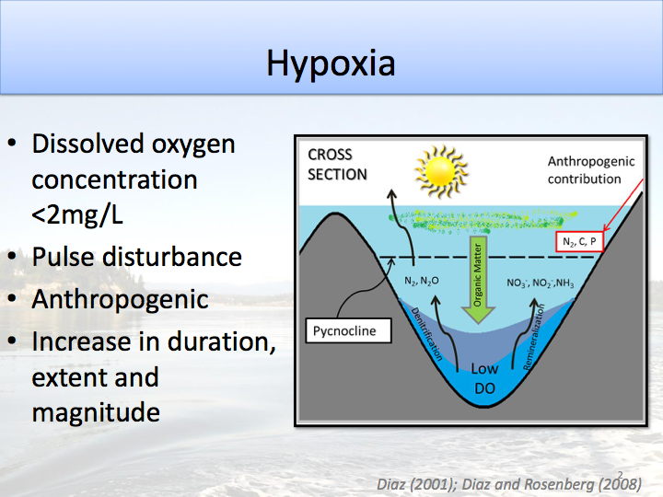

Slide 30
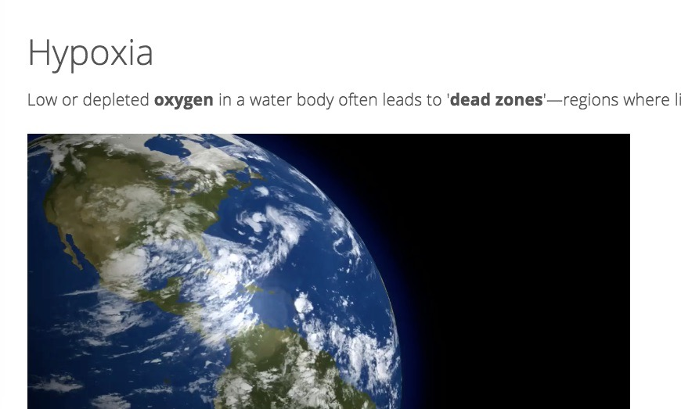
http://oceanservice.noaa.gov/hazards/hypoxia/

Slide 31
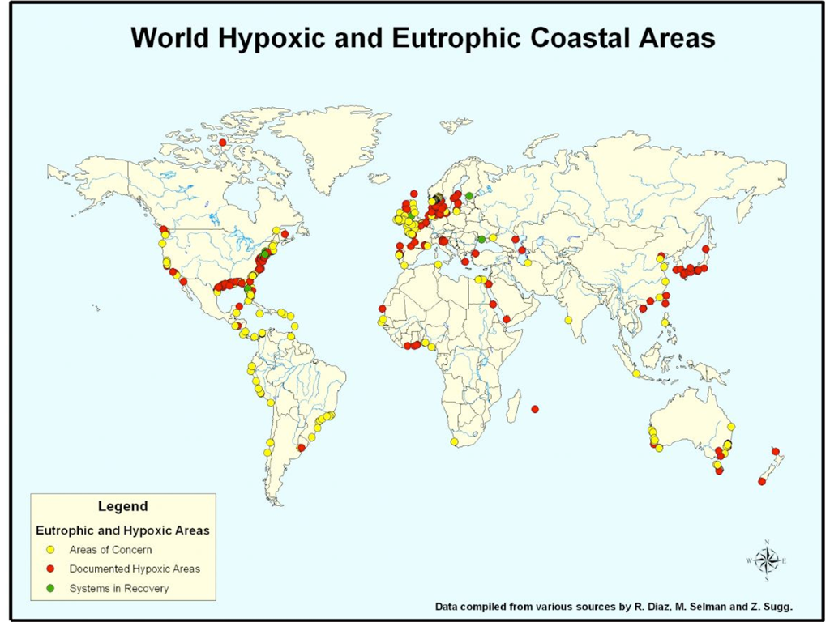

Slide 32
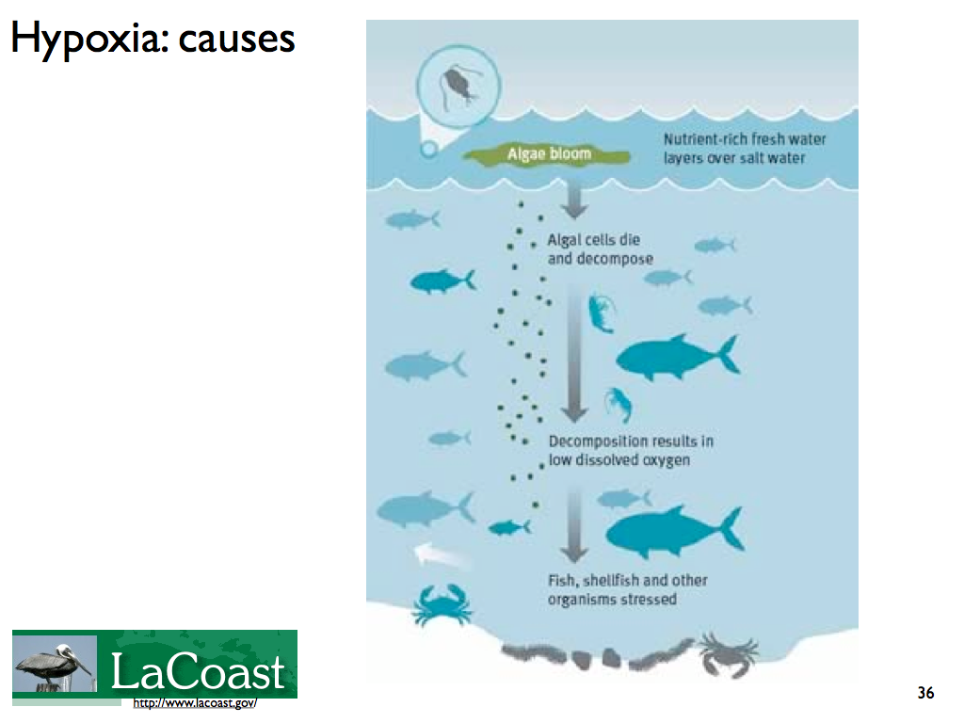

Slide 33
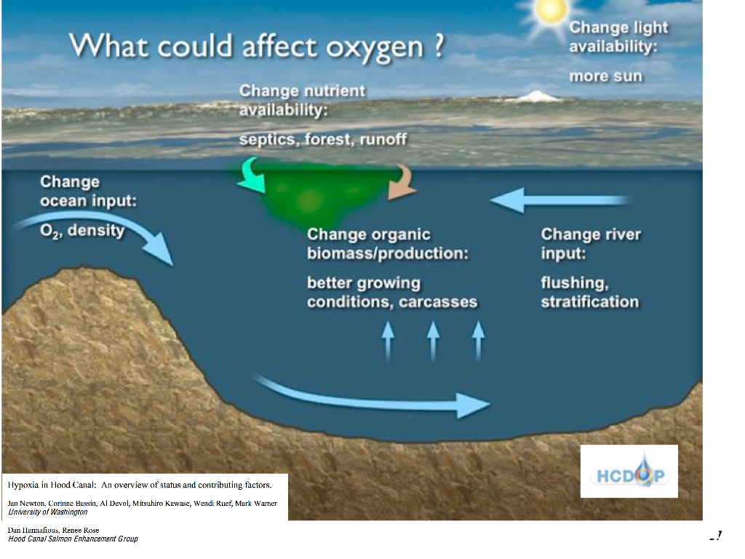

Slide 34
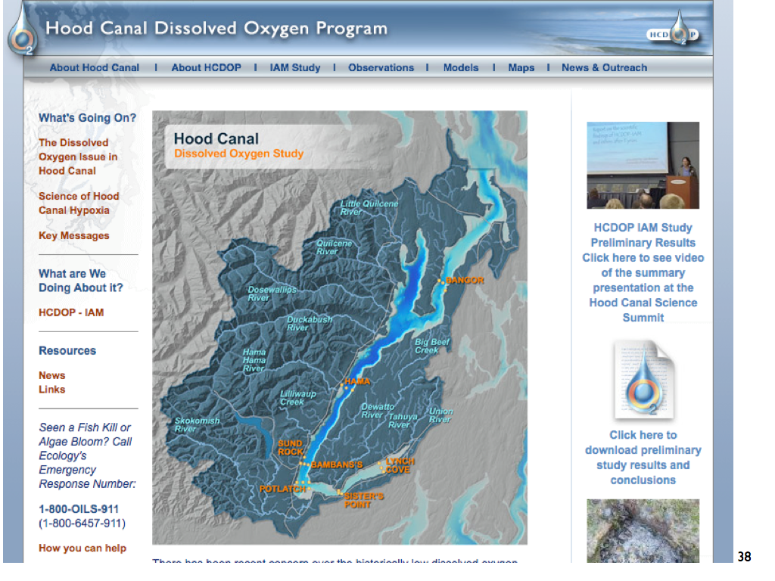

Slide 35
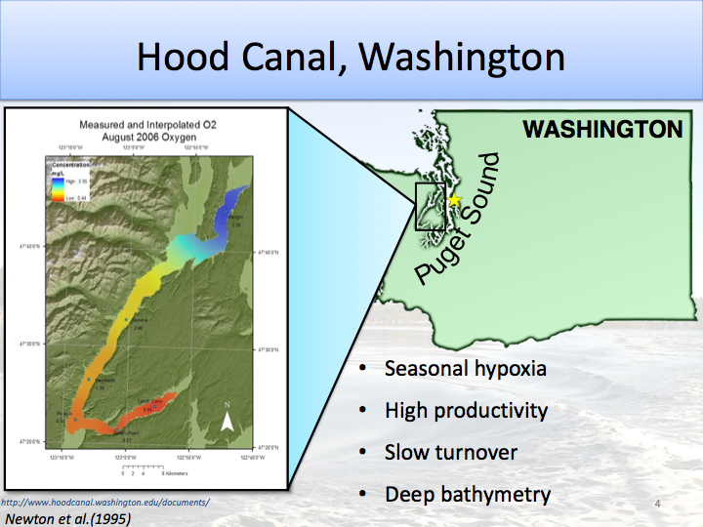

Slide 36
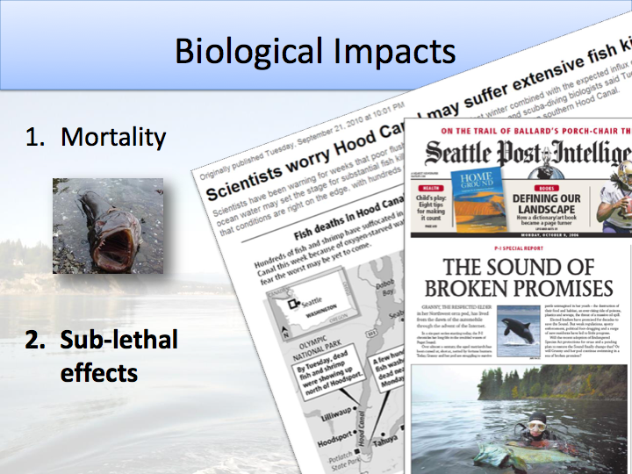

Slide 37
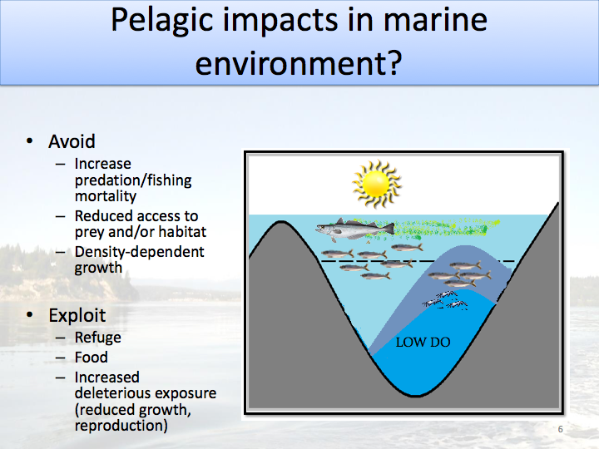

Slide 38
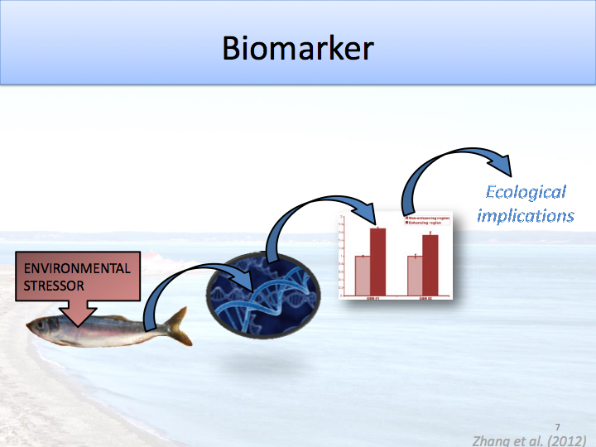

Slide 39
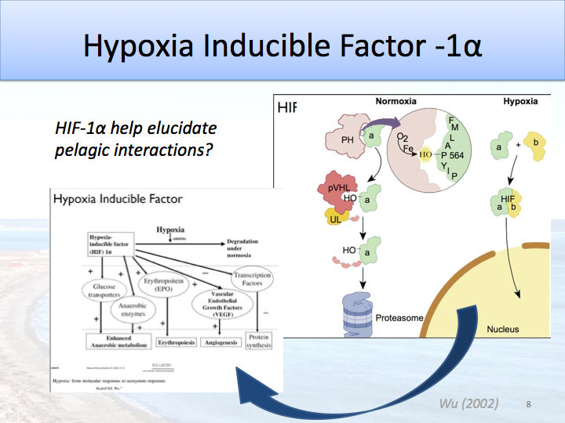

Slide 40
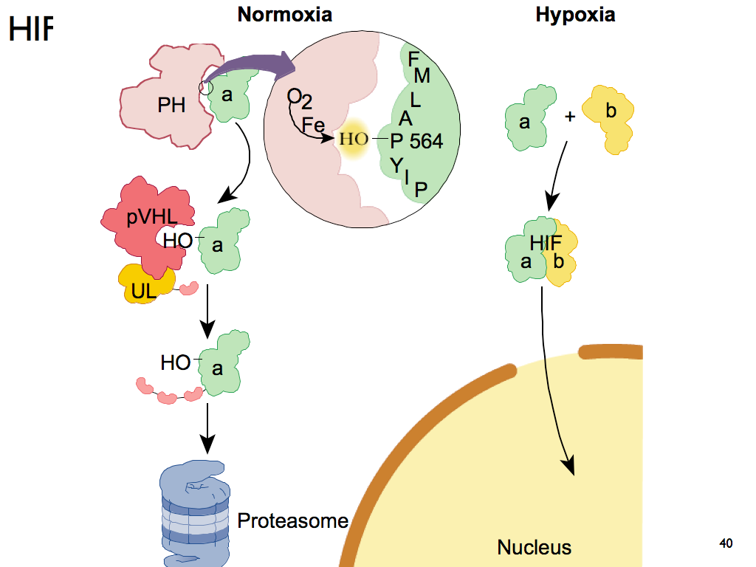

Slide 42
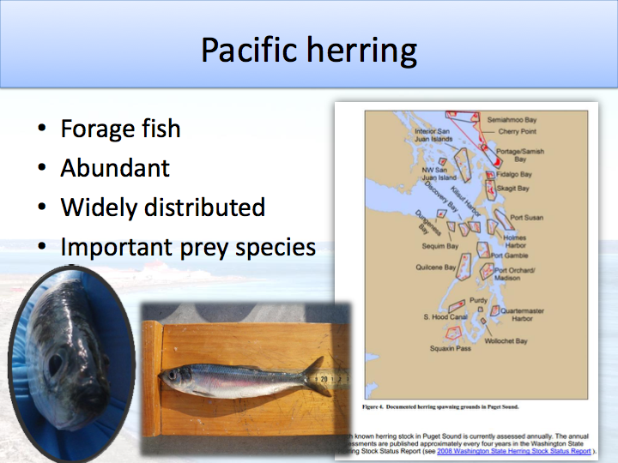

Slide 43
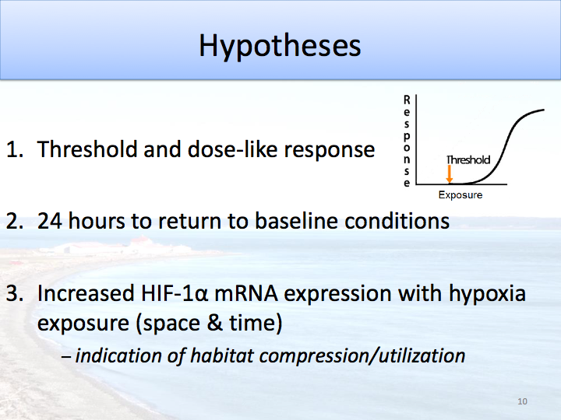

Slide 44
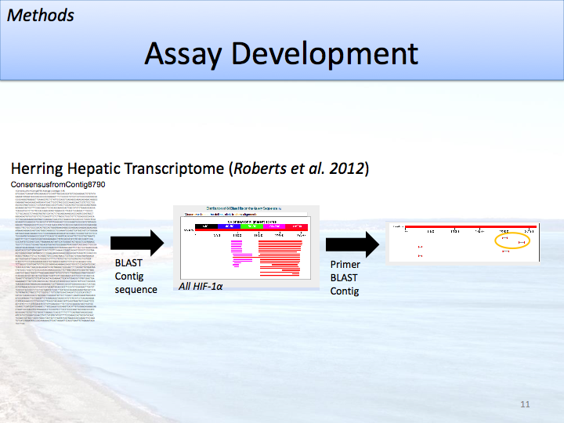

Slide 45
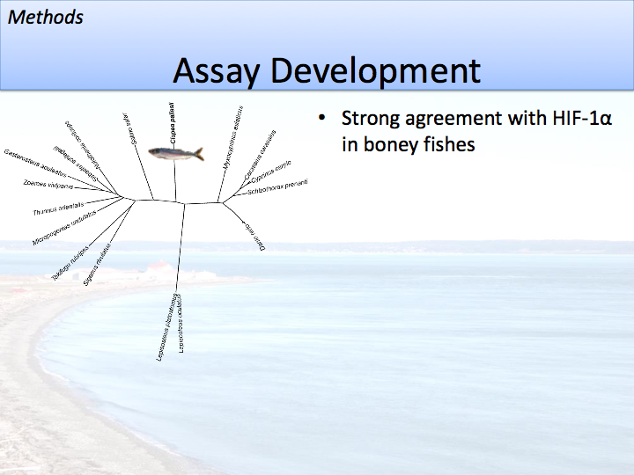

Slide 46
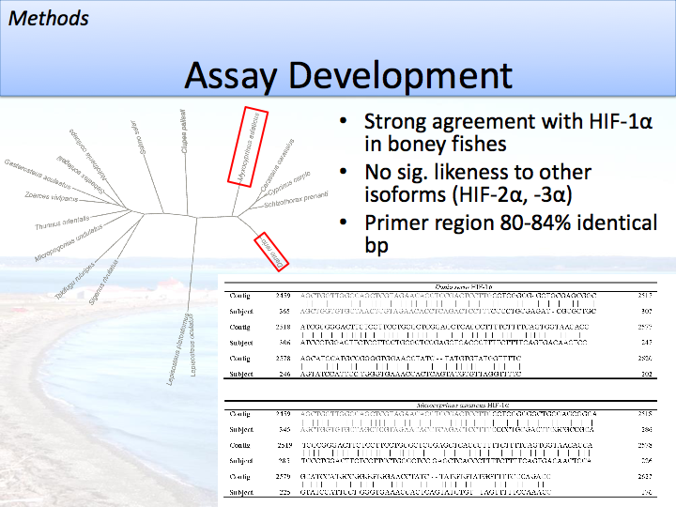

Slide 47
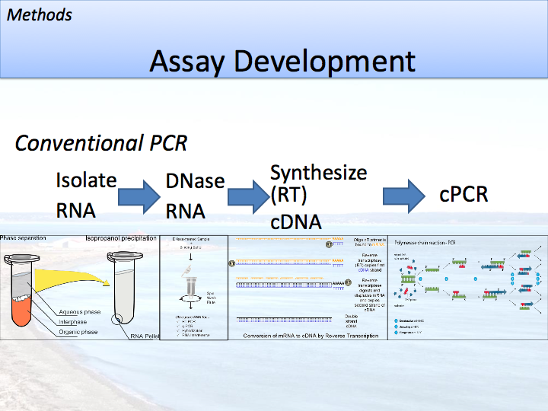

Slide 48
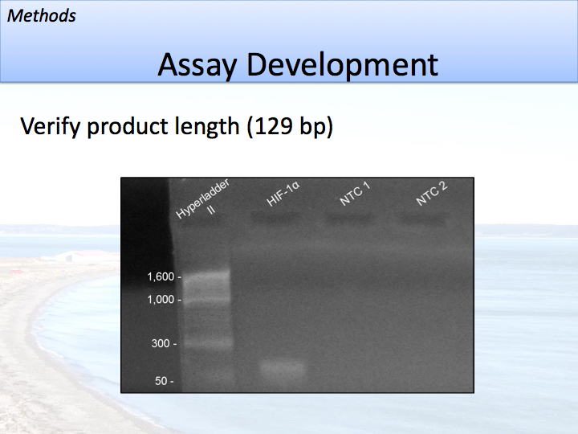

Slide 49
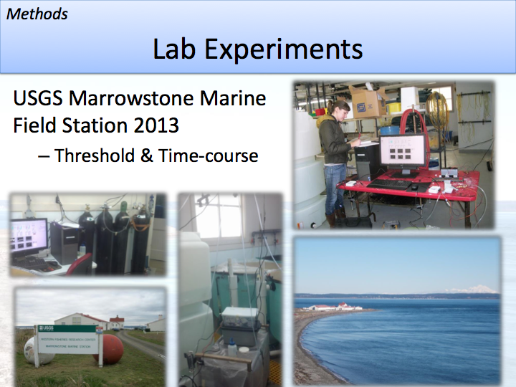

Slide 50
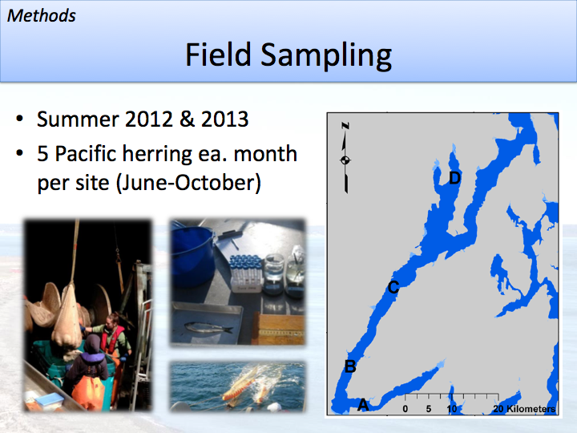

Slide 51
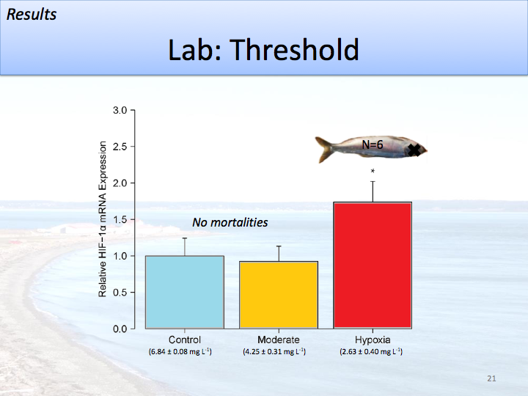

Slide 52
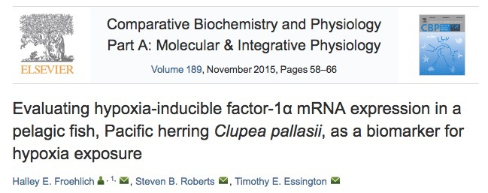

Slide 53
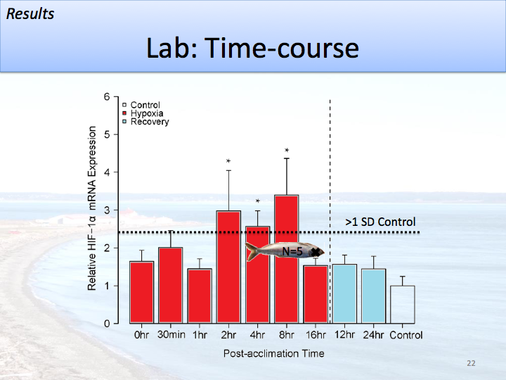

Slide 54
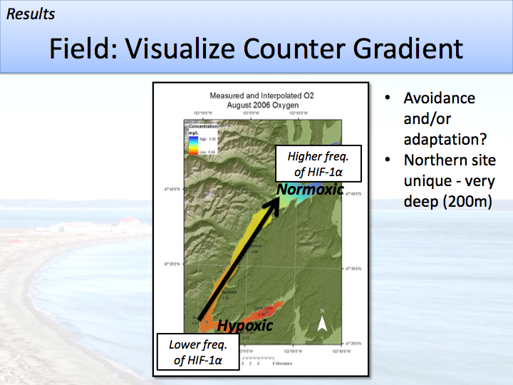

Slide 55
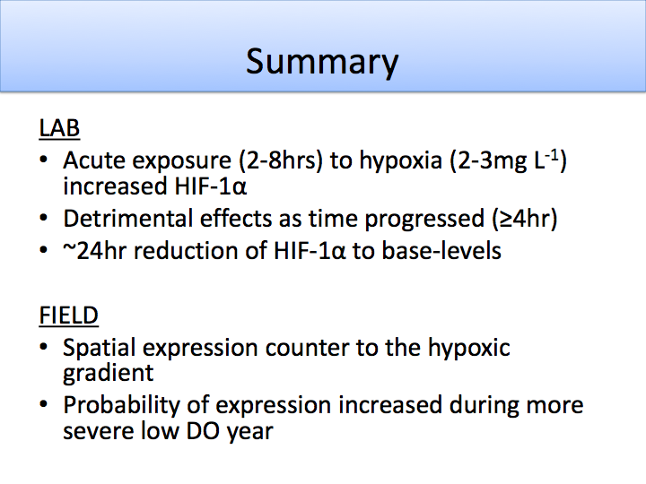

Slide 56
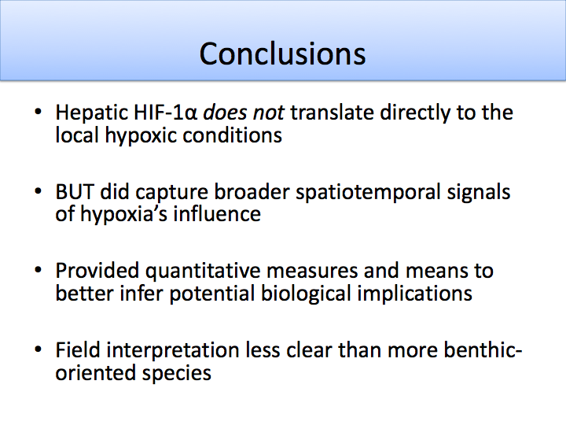

Slide 57
Video

Slide 59
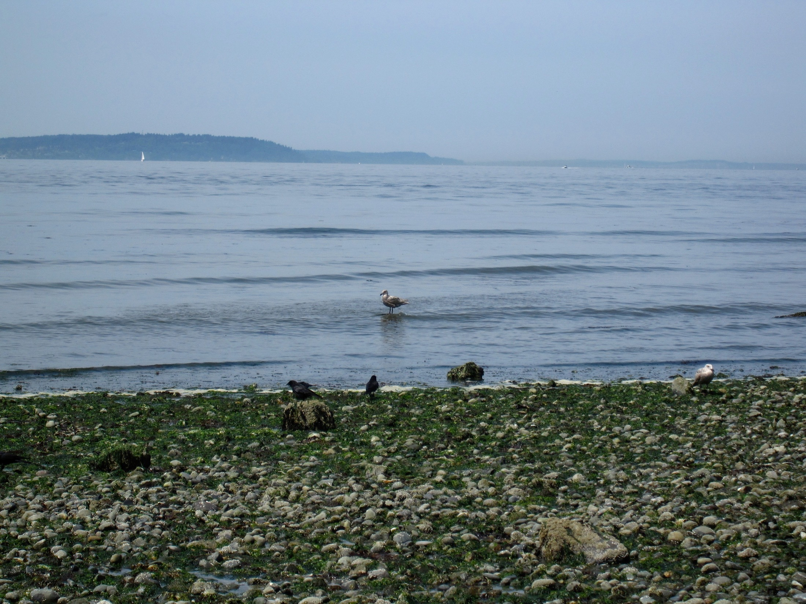
The Ocean is a sink for atmospheric CO₂
The surface ocean absorbs atmospheric CO₂
The efficiency of the oceanic sink for CO₂ will decrease as atmospheric CO₂ increases
Notes:
The surface ocean is in equilibrium with atmospheric CO2 – there is a time lag with this equilibrium because of long time period of ocean mixing
Think of a global Carbon cycle, when rate of production of carbon that can be absorbed is exceeded what happens?

Slide 60
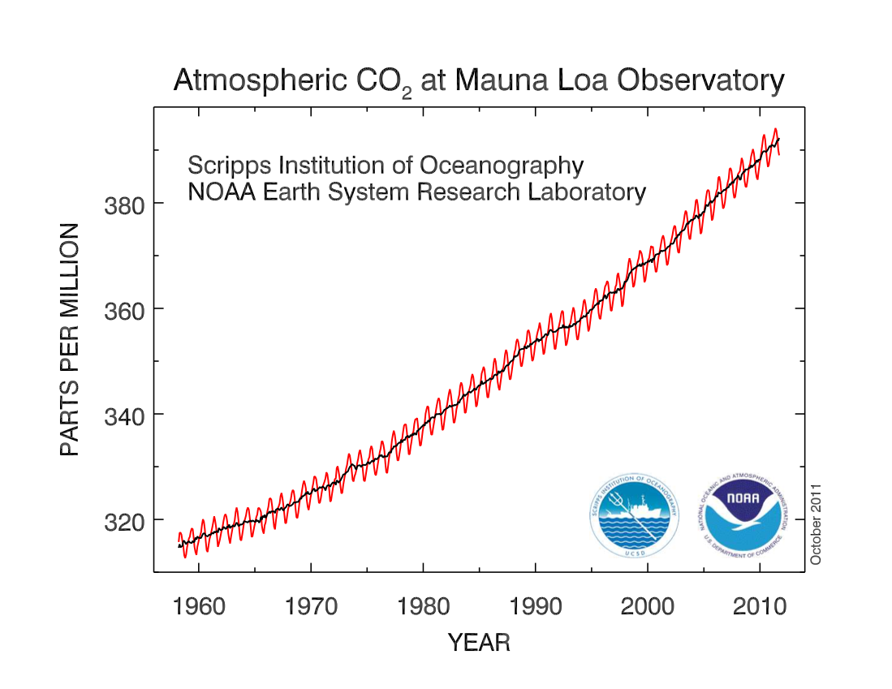
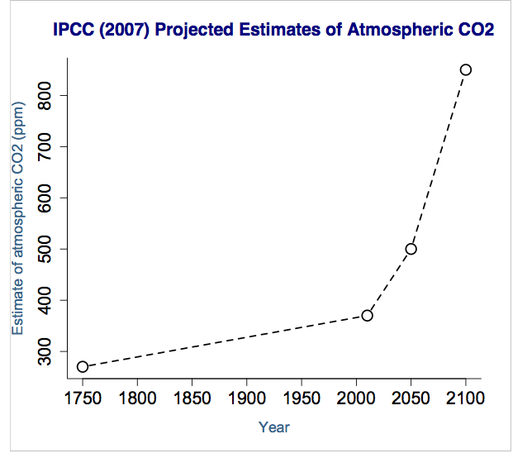
Projected Changes in pCO₂
Notes:
There’s a long-term monitoring of atmospheric CO2 off Hawaii (Mauna Loa Observatory, in red). There is a consistent upward trend (black line) in CO2 that exceeds intra-annual variation (noticable on red line).
The intergovernmental panel on climate change (IPCC) projects that the rate of this CO2 entering the atmosphere will continue increase. Our current atmospheric pCO2 is at about 400 ppm (parts per million), compared with 280 ppm in pre-industrial times.
We measure CO2 in ppm in the atmosphere and in microatmospheres in the water, but they are pretty much the same units (i.e. 400 ppm = 400µatm)

Slide 61
Climate Change
Ocean acidification – concentration of CO₂ in the atmosphere is in equilibrium with seawater
What does this mean for ocean chemistry?
CO₂ (g)
CO₂ (aq) + H₂O
H₂CO₃
H⁺ + HCO₃⁻
H⁺ + CO₃²⁻
Equilibrium lies in this direction AND
excess H⁺ interacts with CO₃²⁻ in solution
Notes:
As CO2 equilibrates with sea water an equilibrium reaction (what does that mean?) occurs. Carbonic acid is formed, then hydrogen ions and bicarbonate. Carbonate could form but the equilibrium lies towards bicarbonate, resulting in more hydrogen ions and less carbonate available.
What is carbonate important?
What do you think will happen to ocean chemistry?

Slide 62
Carbonate Chemistry
Partial pressure of CO₂ (pCO₂)
Gas in the atmosphere is in equilibrium with gas dissolved in sea water
pH
-log[H+]
Dissolved inorganic carbon (DIC)
Total carbon in seawater – contributed to by CO₂ and ions resulting from CO₂ dissociation (HCO₃⁻ and CO₃²⁻)
Total alkalinity (TA)
A measure of the balance between proton donors and proton acceptors
Higher TA can buffer some other changes in carbonate chemistry
Calcium carbonate saturation state (Ω)
How easy it is to form and maintain CaCO₃ structures
Affected by pH, pCO₂ and TA
If Ω<1, then it is harder to make CaCO₃
Notes:
These are the different carbonate chemistry parameters that we can measure. We typically measure two and then we can calculate the rest if we also know salinity and temperature.
For CaCO3 saturation state, we are interested in calcite (less soluble) and aragonite (more soluble), which are both CaCO3 but have slightly different crystal structures

Slide 63
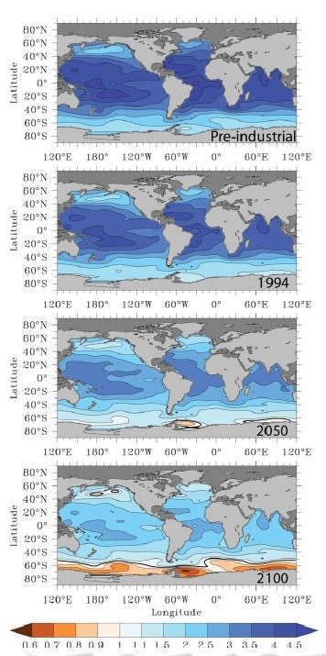
Climate
Change
Excess H⁺ in the ocean will decrease pH
More CO₂ will increase dissolved inorganic carbon
Total alkalinity could change depending on biological changes – although not directly from CO₂
The saturation state of calcium carbonate will decrease
Fabry et al. 2008
Notes:
What happens: DIC goes up, pH goes down, what happens to TA?
Figure shows evolution of surface CaCO3 saturation state. Less than 1 (white – orange) means that it is thermodynamically difficult to make and maintain shells. Notice how different areas (higher latitudes) are affected first.
Most research has been based on the open ocean – the nearshore environment is much more variable and we’re not really sure what is happening now or what will happen (nearshore can be influenced by natural processes such as TA, respiration, photosynthesis, tidal influences, riverine influences)
The higher TA of Ppuget Sound waters means that anthropogenic CO2 is acting relatively slowly in decreasing the pH, but it is still measurable. Puget Sound has low pH due to a variety of other natural processes.

Slide 64
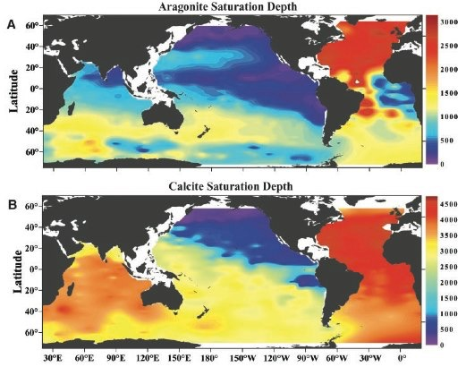
Global Patterns of Ocean Acidification
Some deep water is high in CO₂ – delay of high CO₂ waters reaching shore
Shoaling of undersaturation horizon in worldwide oceans
Feely et al. 2004
Notes:
Deep waters high in CO2 may not reach shore for decades do to large scale of ocean mixing
But already we see a shoaling (becoming more shallow) of the undersaturation depth for CaCO3 – in figure cooler colors are shallower depths for undersaturation
What does this shoaling of undersaturation depth mean for nearshore ecosystems?
Nearshore ecosystems are rich in species diversity and have a high economic value

Slide 65
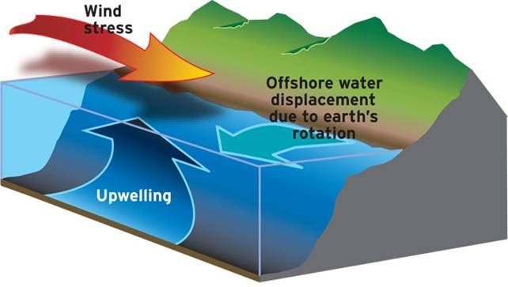
Global Patterns of Ocean Acidification
Notes:
What is upwelling? What have you heard about its impacts on the aquatic environment?
Sometimes these high pCO2 waters are upwelled into the nearshore environment.
Upwelling is caused by wind stress along the shore. Surface waters are pullled offshore and replaced by deeper water.

Slide 66
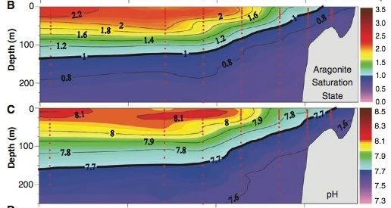
Global Patterns of Ocean Acidification
Upwelling systems are typically very productive
Upwelled waters bring deeper water into shallow habitats – high in CO₂, low in pH
Feely et al. 2008
Notes:
Upwelled waters are high in nutrients and promote productivity
Upwellings can also be low in DO; contain bacterial pathogens like Vibrio tubiashii – stressful environment could make the host more susceptible to the disease
Even in present day conditions in certain environments we see relatively small scale flucuations that cause ocean acidification conditions. As CO2 rich waters continue to upwell in the nearshore area, these low pH events will become more common and last for longer periods of time.

Slide 67
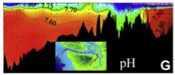
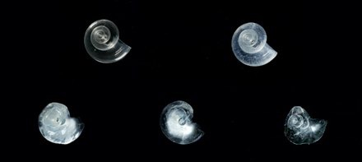
Consequences for the Ecosystem
Kilometers along transect
Feely et al. 2010
Notes:
Hood Canal demonstrates a pattern of decreased pH as you go south. Notice south Hood Canal has water as low as 7.4. This pH may be low enough to corrode CaCO3 shells.

Slide 68

Historic Patterns of Ocean Acidification
Ocean acidification has occurred in the past but never to the degree (magnitude and rate) at which it is currently occurring
Zeebe 2011
Notes:
Many people usually ask, what about adaptation? There were ocean acidification events in the past and animals survived. How do those events compare to what we see today?
These graphs show historic, current (red), and projected future data (green and blue for different emissions scenarios) for pCO2, CaCO3 saturation, and ocean pH. Apparent from these graphs is that historically pCO2 and pH were relatively stable. Already anthropogenic emissions of CO2 have caused significant deviationsn from historic variability.

Slide 69


Historic Patterns of Ocean Acidification
The most similar event: Paleocene-Eocene Thermal Maximum
~55 Million years ago
Occurred over a few thousand years
Temperature increased ~5-9°C and there were large released of C
Zeebe 2011
Notes:
The historic period the most similar to what is currently occurring was the Paleocene-Eocene Thermal Maximum (orange on graphs compared to current/projected pCO2 in blue). The carbon emissions during the PETM were most likely do to increased volcanic activity. These emissions occurred over a much longer time scale and less C was released than what is expected in the future given current trends.
There were also many extinction events likely linked to the lowered oceanic pH during the PETM.

Slide 70
Organism Response
At all life stages, attempts to maintain homeostasis under acidic conditions will come with energetic costs
Which physiological processes will be affected by OA?

Slide 71
Organism Response
Changes in extra- and intracellular pH
Possibility of buffering with HCO₃⁻
Membrane proteins could correct H⁺ imbalance
Shell dissolution common at all life stages
Changes in physiological pathways:
Energy metabolism
Molecular chaperones
Ion transport
Calcification
Development
Notes:
Buffering of internal changes in pH can come from “purposeful” dissolution of the shell

Slide 72





Experimental Design
Equilibrate treatment water
Fertilization
1 hpf
6 hpf
24 hpf
72 hpf
96 hpf
Fix samples for developmental stage, size, and calcification
Notes:
An example of investigating the effects of elevated pCO2 on larval Pacific oysters

Slide 73

Notes:
Average pH was separate for the 3 treatments: 400 µatm (Ambient, pH ~8.0), 700 µatm (MidCO2, pH~7.8), 1000 µatm (HighCO2, pH ~7.65)

Slide 74

Dissolution
threshold
Notes:
The “dissolution threshold” at 1 means that it becomes thermodynamically difficult to make/maintain shell.
Aragonite saturation (open triangles) is always lower than calcite (closed) because it is more soluble
Only 1000 µatm crosses below the threshold

Slide 75


Timmins-Schiffman et al. 2013
Notes:
Calcification is measured using polarized light. The polarized filter makes the CaCO3 shine.
On day 1 (green larva) calcification = CaCO3 at the hinge; this is the beginning of calcification
On day 3 (pink larva) calcification = maltese cross on the shell, fully shiny
Significantly more larvae at highCO2 had calcified material on day 1, but on day 3 significantly fewer at highCO2 were fully calcified

Slide 76


Timmins-Schiffman et al. 2013
Notes:
There was no difference in larval size for hinge length (white bar on larval picture) across treatments on day 1. By day 3, larvae at ambient and midCO2 were significantly larger than those at highCO2.
At MidCO2 on day 3 larvae were significantly larger from Day 1

Slide 77

Timmins-Schiffman et al. 2013
Notes:
Same trend - There was no difference in larval size for shell height across treatments on day 1. By day 3, larvae at ambient and midCO2 were significantly larger than those at highCO2.
At Ambient and MidCO2 on day 3 larvae were significantly larger from Day 1. Notably, larvae at highCO2 were not significantly larger for shell height or hinge length by day 3.

Slide 78

Timmins-Schiffman et al. 2013
Notes:
By plotting shell height versus hinge length we can get a sense of the changing allometry of the larvae throughout early development. If larvae maintain the same allometry (proportions), we assume that they are following the same developmental trajectory. The goal of this is to tease apart if larvae are experiencing a developmental delay (they would be smaller, but have the same allometry), or if they actually have smaller shells (smaller and different allometry). The latter might indicate problems with the calcification mechanism.
Slopes of lines are statistically the same, therefore the larvae are demonstrating developmental delay.

Slide 79
Conclusions
Elevated pCO₂ puts stress on larvae, leading to different allocations of internal energy reserves for metabolic processes
The phenotype associated with these changes is developmental delay
What is the significance of these changes?
Notes:
By delaying development, the larvae could be reserving necessary resources to survive the stress. Interestingly, when there was no difference among treatments (day 1) the larvae were still relying on maternal energy resources. The developmental delay coincides with the larvae switching to feeding on their own. This has also been observed in other species.

Slide 80

Significance
Recent studies have shown that OA effects on larval stages continue to affect growth and survival at later stages
Knowledge about how carbonate chemistry affects larval stages can help mitigate effects in the hatchery (Barton et al. in press)
Notes:
There is a cost to OA – growth, calcification
What are the molecular underpinnings of this cost? Where is the energy budget being spent?

Slide 81
http://eagle.fish.washington.edu/emma/

